Slide 1
POV & Experience Prototypes: Student Burnout
Team EduCAUtion

Slide 2
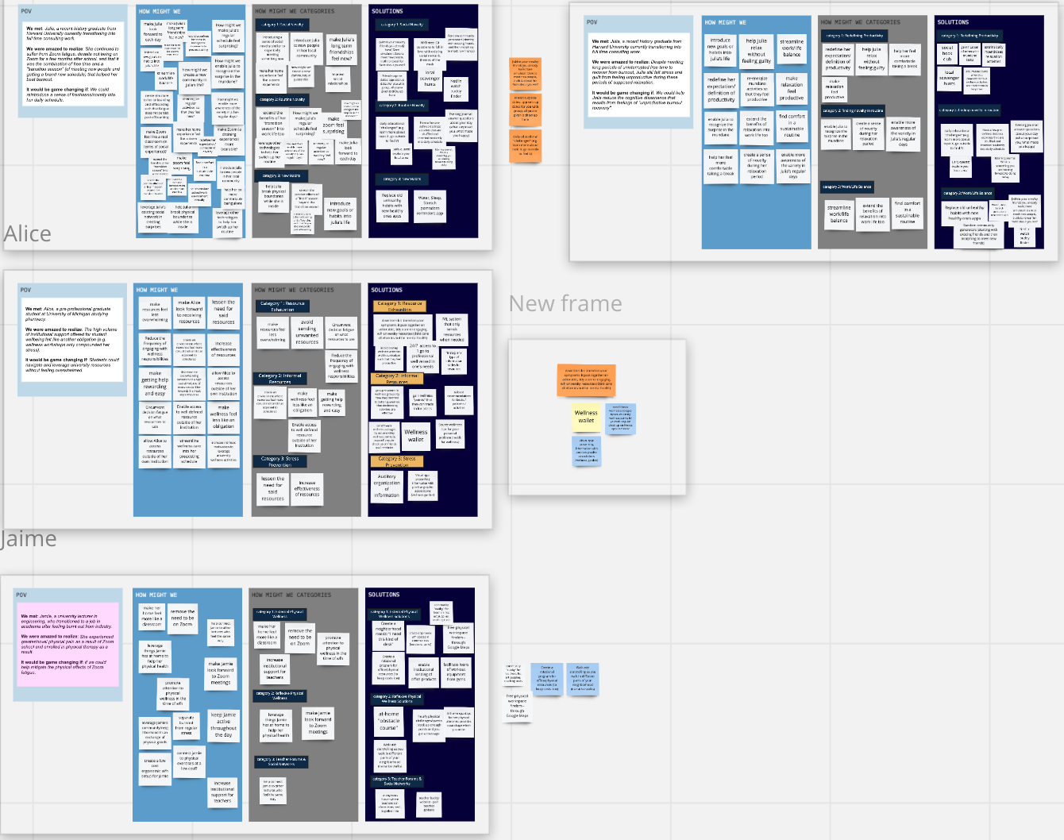
POV & HMW Generation

Slide 3
POV 1: Julia
We met: Julia, a recent history graduate from
Harvard University currently transitioning into
full time consulting work.
We were amazed to realize: Despite needing long periods of uninterrupted free time to recover from burnout, Julia still felt stress and guilt from feeling unproductive during these periods of supposed relaxation.
It would be game changing if: We could help Julia reduce the cognitive dissonance that results from feelings of "unproductive burnout recovery".

Slide 4
HMW make relaxation feel productive?

Slide 5
POV 2: Alice
We met: Alice, a pre-professional graduate student at University of Michigan studying pharmacy.
We were amazed to realize: The high volume of institutional support offered for student wellbeing felt like another obligation (e.g. wellness workshops only compounded her stress).
It would be game changing if: Students could navigate and leverage university resources without feeling overwhelmed.

Slide 6
HMW make getting help rewarding and easy?

Slide 7
POV 3: Jaime
We met: Jamie, a university lecturer in engineering, who transitioned to a job in academia after feeling burnt out from industry.
We were amazed to realize: She experienced greater/novel physical pain as a result of Zoom school and enrolled in physical therapy as a result.
It would be game changing if: We could help mitigate the effects of zoom fatigue.

Slide 8
HMW keep Jaime active throughout the day?

Slide 9
3 Experience Prototypes

Slide 10
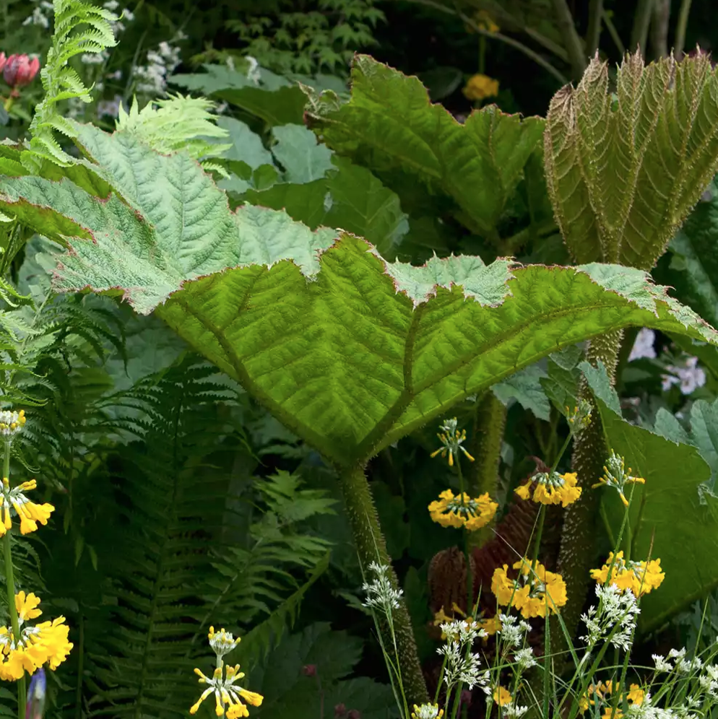
Experience Prototype #1: Educational Quests
Assumption: People will derive a sense of productivity and rejuvenation from short, educational tasks as opposed to the cultivation of long term habits.
Place your screenshot here

Slide 11
Overview:
Gave the participant two choices: find the hex color of your wall or find a plant you are interested by in your garden.
Takeaways:
Assumption disproved: Did not feel that it was relaxing enough to motivate her to do it again.
Prefers passive forms of relaxation/gaining knowledge like reading a book or listening to a podcast, rather than the physicality of questing.
She did feel like she gained new knowledge/was productive with some of her free time.
Participant wasn’t particularly interested in the nature/color aspects of the choices, but she said she liked the shortness of the task and felt a newfound appreciation for her space
Notes:
To learn more about plant: used planta (an application that identifies a plant based on a picture you take)

Slide 12
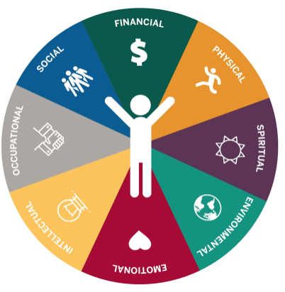
Experience Prototype #2: Wellness Kits
Assumption: If we make resource navigation less text heavy, more visually soothing, and more action oriented, people will be more likely to utilize wellness resources.
Personalization allows the subject to better engage with resources -- shifts focus from quantity to quality of care.
Place your screenshot here

Slide 13
Overview:
Showed participant 2 lists: original list (modeled after university’s standard “wellness week” emails). 2nd list: personalized, actionable list to match their situation
Takeaways
Assumption proved: Preferred the personalized, more visual list
Not necessarily because it reduced information but because it catered to demand of her schedule
The standard list didn’t necessarily stress her out
Was almost the opposite -- underwhelming because they didn’t have good options
Notes:
Debriefed and asked participants questions such as the following:
Which list do you find more informative?
Which list do you find more appealing?
Found lots of activities on the standard lists not useful
Liked the counseling sessions but too open ended -- the slots were really limited and had no way of gauging how full they were
Lots of activities that she either couldn’t attend due to schedule conflict or too far.

Slide 14
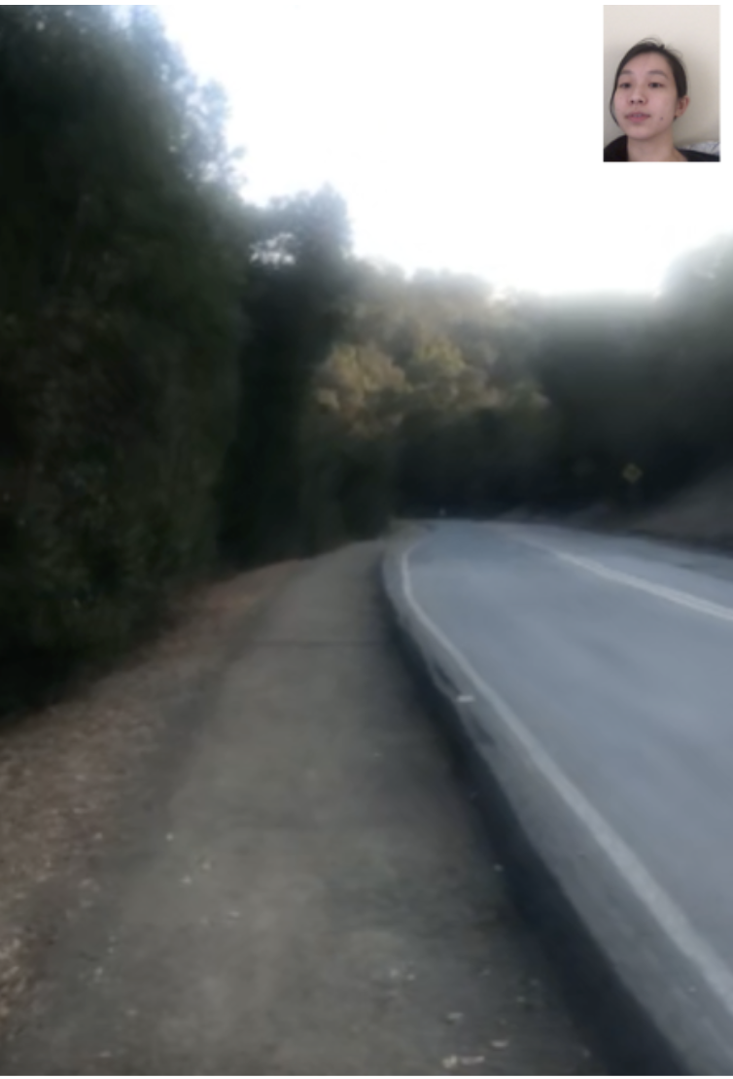
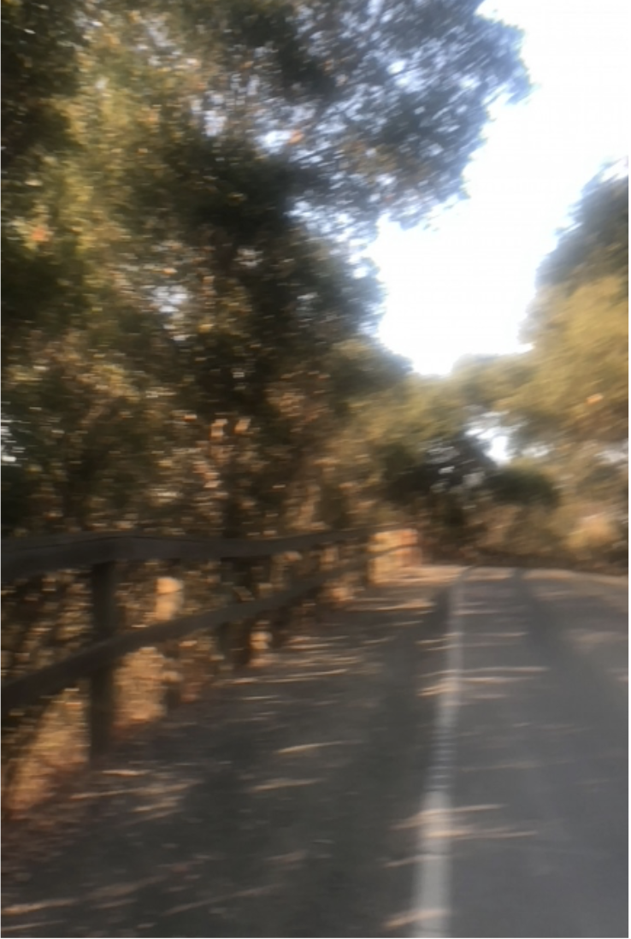
Experience Prototype #3: Narrative Walks
Assumption: People have the spare time during a work day to engage physically with their surroundings, and they are more likely to want to be active when they feel personally connected to the space.
Place your screenshot here

Slide 15
Overview:
Through FT, 1 person voiced/narrated surroundings to participant as participant went on their walk. Another person took notes of the situation, the participants reaction, and jotted down verbal/ non-verbal cues from the participant to gauge their engagement.
Takeaways:
Assumption proved: She felt more connected to the space and felt like she learned from the experience.
Participant doesn’t generally like silence when she walks, likes being “distracted” the whole time
Takes daily walks as is, so isn’t sure if this will actually motivate her to walk more, but she appreciated the experience

